Slide 1

Customer Churn Analysis
By Juston Suell
Bellevue University
DSC530 - Data Exploration and Analysis

Slide 2
Statistical Question
My main hypothesis for this analysis is:
"Do longer-tenured customers and those on longer-term contracts have lower churn rates, and how do monthly and total charges affect churn?"

Slide 3
Dataset Overview
The Dataset used in this project is the Telco Customer Churn from Kaggle.com (reference)
It contains information about customer demographics, services subscribed to, and account information, all of which can be used to predict customer churn.

Slide 4
Variables Used
For this project, I focused on the following five variables:
Tenure: The number of months the customer has been with the company.
MonthlyCharges: The amount charged to the customer monthly.
TotalCharges: The total amount charged to the customer.
Contract: The type of contract the customer is on (Month-to-month, One year, Two year).
Churn: Whether the customer has churned or not.
These variables are selected based on their potential impact on customer churn and relevance to our statistical question.

Slide 5
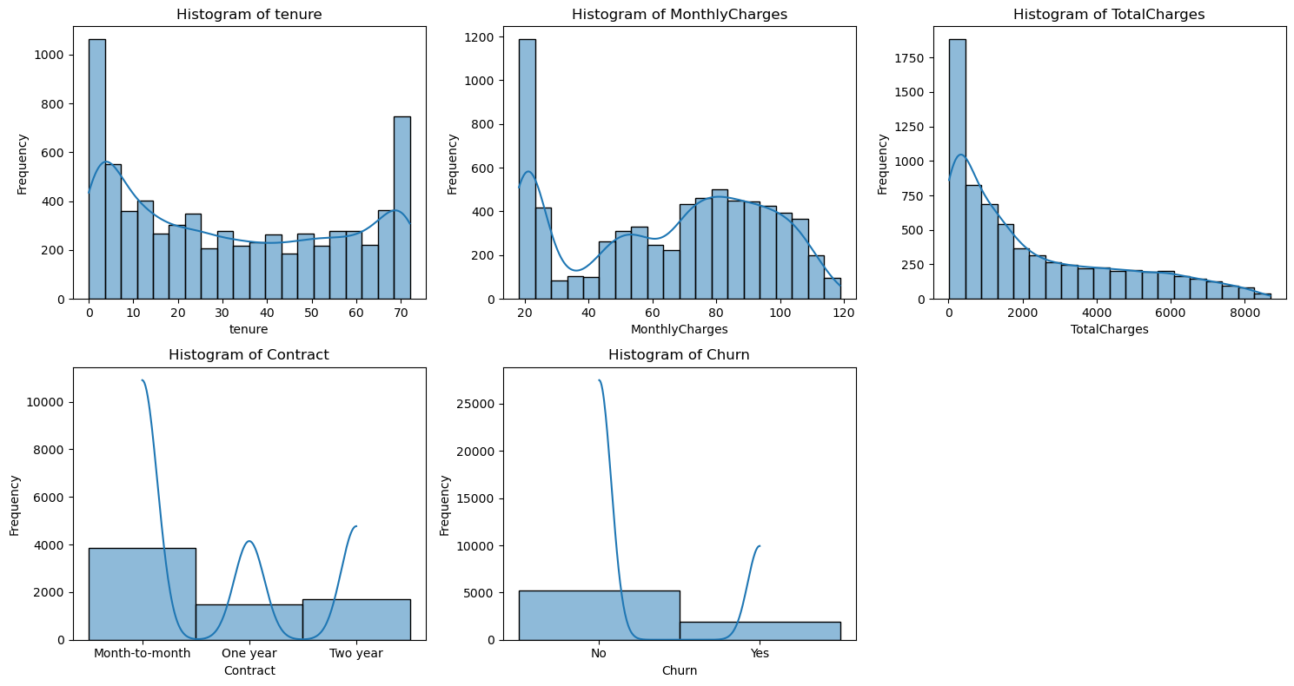
HISTOGRAMS AND ANALYSIS

Slide 6
descriptive characteristics for variables
Tenure:
Mean: 32.37 months
Mode: 1 month
Standard Deviation: 24.56
Skewness: 0.24
Kurtosis: -1.39
MonthlyCharges
Mean: $64.76
Mode: $20.05
Standard Deviation: 30.09
Skewness: -0.22
Kurtosis: -1.26

Slide 7
descriptive characteristics for variables cont.
TotalCharges:
Mean: $2283.30
Mode: $20.20
Standard Deviation: 2266.77
Skewness: 0.96
Kurtosis: 0.14
Tenure - shows a right-skewed distribution, with most customers having short tenures. There are a few outliers on the longer side, representing customers who have been with the company for a significant period.
MonthlyCharges - slightly left-skewed, indicating that while most customers pay average amounts, there are fewer customers at the extreme ends of monthly charges.
TotalCharges - heavily right-skewed, suggesting that a substantial number of customers have accumulated lower total charges, while a minority have high total charges. The presence of outliers may be due to long-term customers.

Slide 8
PMF Analysis
Churned Customers: The PMF shows higher probabilities for lower tenures, indicating that customers with shorter tenures are more likely to churn.
Not Churned Customers: The PMF suggests that longer-tenured customers tend to remain with the company, supporting our hypothesis.

Slide 9
CDF Analysis
The CDF of ‘MonthlyCharges’ reveals that:
A significant proportion of customers have lower monthly charges, indicating a potential churn risk.
Also, customers with higher charges are less frequent, suggesting premium service engagement and potentially higher retention.

Slide 10
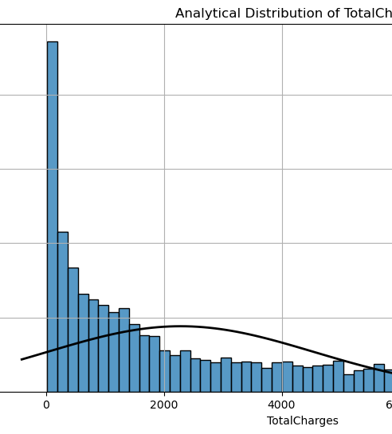
Analytical Distribution Analysis
The normal distribution provides a good approximation of the ‘TotalCharges’ data, though there are deviations at the tails, possibly indicating outliers or a non-normal spread. This aligns with the earlier observation of a right-skewed distribution.

Slide 11
Scatter Plot Analysis
Tenure vs. MonthlyCharges
TotalCharges vs. MonthlyCharges:
Correlation: Moderate positive correlation (0.23), indicating that as tenure increases, monthly charges tend to increase slightly
Covariance: Positive covariance suggests a linear relationship, though it's not strong enough to imply causation.
Correlation: Strong positive correlation (0.65), indicating that higher monthly charges are associated with higher total charges.
Covariance: High positive covariance supports a strong linear relationship, potentially indicative of causation

Slide 12
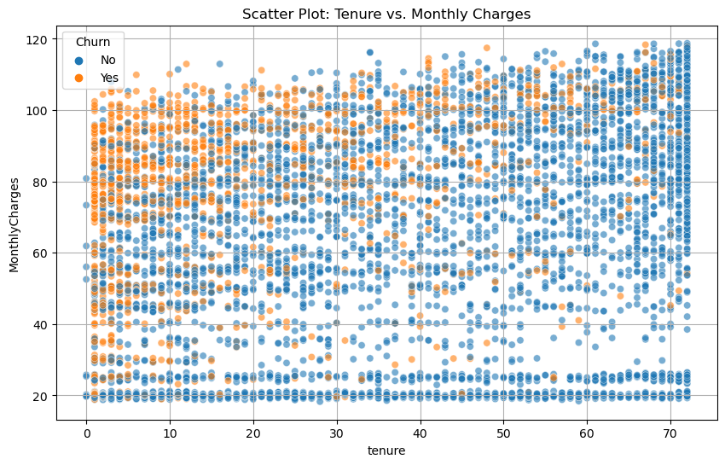
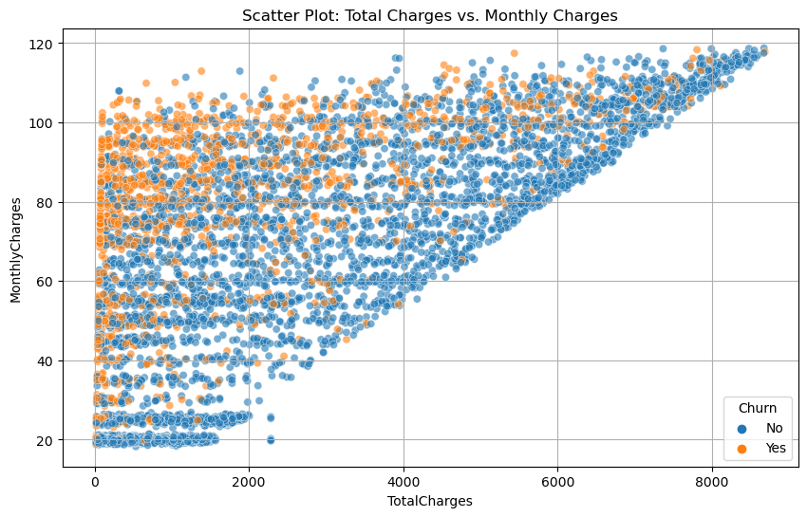
Scatter Plot Analysis cont.
Correlation(Tenure, MonthlyCharges): 0.25
Covariance (Tenure, monthlyCharges): 183.20
Correlation(Totalcharges, MonthlyCharges): 0.65
Covariance (Totalcharges, monthlyCharges): 44331.98

Slide 13
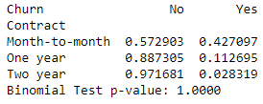
Hypothesis Testing
The binomial test compares churn rates between month-to-month and two-year contract customers. A low p-value (< 0.05) would indicate a significant difference in churn rates, supporting the hypothesis that contract type influences churn.

Slide 14
Regression Analysis Summary
Tenure: Longer tenure is negatively associated with churn, suggesting that customers with longer tenures are less likely to churn.
MonthlyCharges: Higher monthly charges are positively correlated with churn, indicating that higher bills may drive customers to leave.
Contract Type: Customers on longer contracts have lower churn rates, supporting the hypothesis

Slide 15
Reference
B. (n.d.). Telco Customer Churn. Kaggle. https://www.kaggle.com/datasets/blastchar/telco-customer-chur

